Slide 1

RISC-V SoC for Computer Vision Applications
Tutorial 3: Creating Custom IP from HDL with AMBA Bus Interface
EE 297
Friday, December 17, 2020
Project Members:
Anee Mineshkumar Dubhia^{[1]}
Chee Vang^{[2]}
Advisor:
Professor Harry Li, Ph. D.^{[3]}

Slide 2
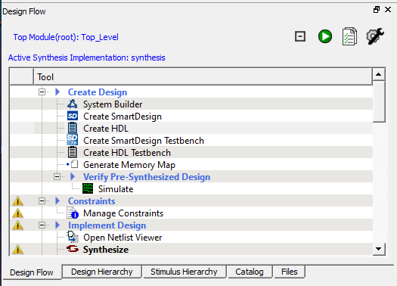
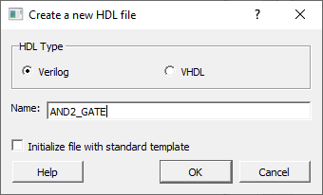
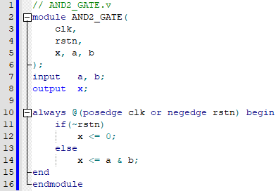
Step 1: Create HDL File
NOTE: We are using the existing FPGA projects from Future Electronics: https://github.com/Future-Electronics-Design-Center/Creative-Eval-Board
Unzip the project located IGL2_MiV_FreeRTOS_Demo > FPGA Design
Open Libero SoC v12.0 or higher and open the project that was unzipped
Create a new HDL file by going to Design Flow > Create HDL
Select Verilog for HDL Type and give the file a name.
Click OK.
Enter the AND gate Verilog code
Fig. 1. Design Flow window to create a new HDL file
Fig. 2. Create a new HDL file
Fig. 3. Verilog code for AND gate

Slide 3
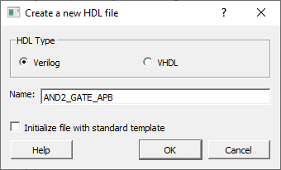
Step 2: Create APB Wrapper for Custom Core
Create a new HDL file from Design Flow
Select Verilog for HDL Type and give it name with _APB to know that this is the APB wrapper
Fig. 1. Design Flow window to create a new HDL file

Slide 4
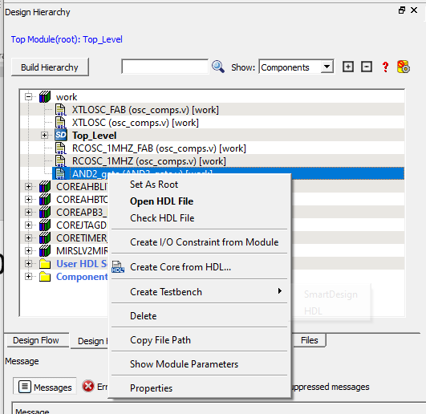
Step 3: Create Core From HDL
Select Design Hierarchy
Click on Build Hierarchy for the Verilog HDL file to appear
Right-click the HDL file and select Create Core form HDL
Click Yes to add bus interface
Fig. 4. Design Hierarchy window to create core from HDL
Fig. 5. Message to add parameters or bus interface to a new core from HDL

Slide 5
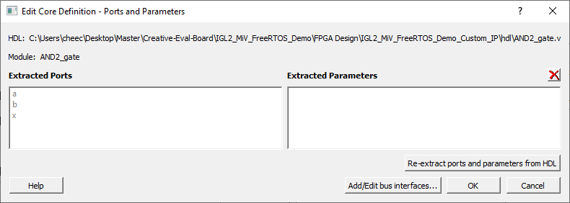
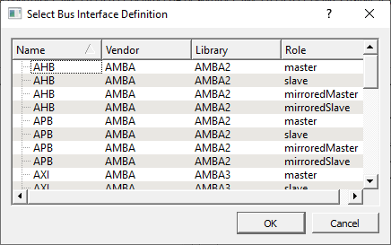
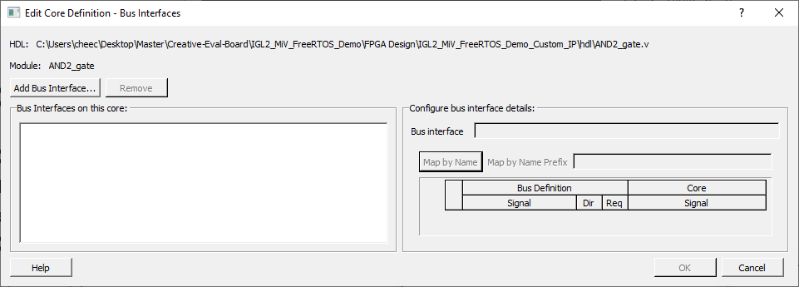
Step 4: Add APB Bus Interface
In Edit Core Definition – Ports and Parameters window, click on Add/Edit bus interfaces
In Edit Core Definition – Bus Interfaces window, click on Add Bus Interface
Select APB slave
Click OK

Slide 6
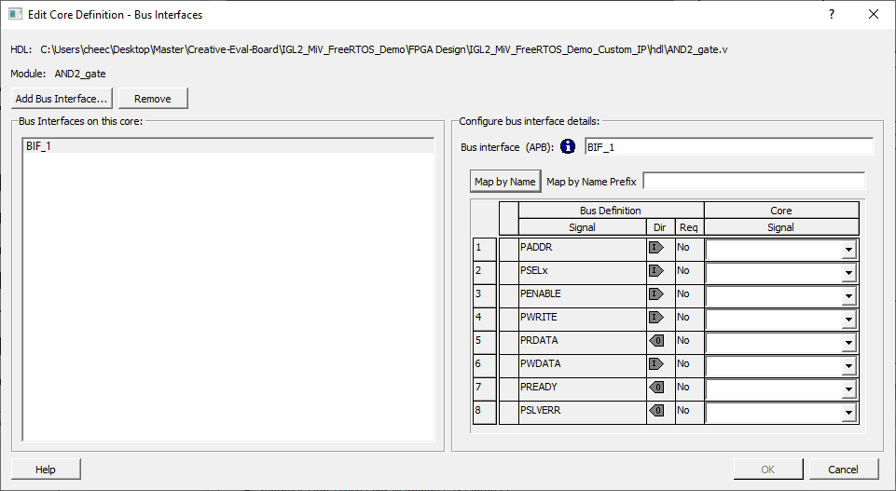
Step 5: Edit APB BuS
Click on Map by Name to automatically map the signals
Click OK
Click OK in Edit Core Definition – Ports and Parameters window

Slide 7
Step 5: Edit APB BuS
In Design Hierarchy, the AND2_gate HDL file should be slightly difference (larger “HDL+” with blue background)
If not, then click on Build Hierarchy
Drag and drop the component into the SmartDesign

Slide 8
Thank You!

